Slide 1
Ultrasound localization system
Project number: 17-2-1-1488
Roi Toledano 203700505
Yareden Avraham 302249925

Slide 2
Outline
Motivation
The Problems & setup definitions
Suggested Algorithms
ToA detector
Choosing the best signal
Chan’s TDOA
Room LUT
Difficulties
Results
Conclusions
Notes:
How presentation will benefit audience: Adult learners are more interested in a subject if they know how or why it is important to them.
Presenter’s level of expertise in the subject: Briefly state your credentials in this area, or explain why participants should listen to you.

Slide 3
Motivation
Finds the location of bats in theirs colony in order to get accurate tracking.
Overcome GPS's indoor localization disabilty.
Purpose of the Project:
Planning and developing a localization system that mimics the way bats position themselves in space today. Examining different algorithms using different signals that are being transmitted.
Use cases:
Indoor GPS.
Robotic self movement in room.
Notes:
Lesson descriptions should be brief.

Slide 4
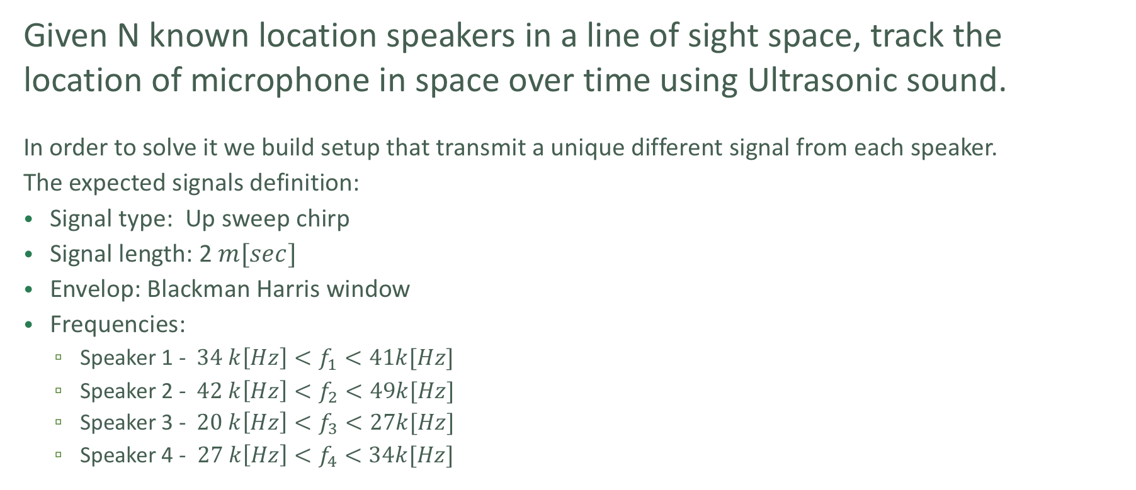
The Problem & setup Definitions
Given N known location speakers in a line of sight space, track the location of microphone in space over time using Ultrasonic sound.
In order to solve it we build setup that transmit a unique different signal from each speaker.
The expected signals definition:
Signal type: Up sweep chirp
Signal length: 2$m[sec]$
Envelop: Blackman Harris window
Frequencies:
Speaker 1 - $34 k\left[Hz\right]<f_{1}<41k[Hz]$
Speaker 2 - $42 k\left[Hz\right]<f_{2}<49k[Hz]$
Speaker 3 - $20 k\left[Hz\right]<f_{3}<27k[Hz]$
Speaker 4 - $27 k\left[Hz\right]<f_{4}<34k[Hz]$
Notes:
Example objectives
At the end of this lesson, you will be able to:
Save files to the team Web server.
Move files to different locations on the team Web server.
Share files on the team Web server.

Slide 5
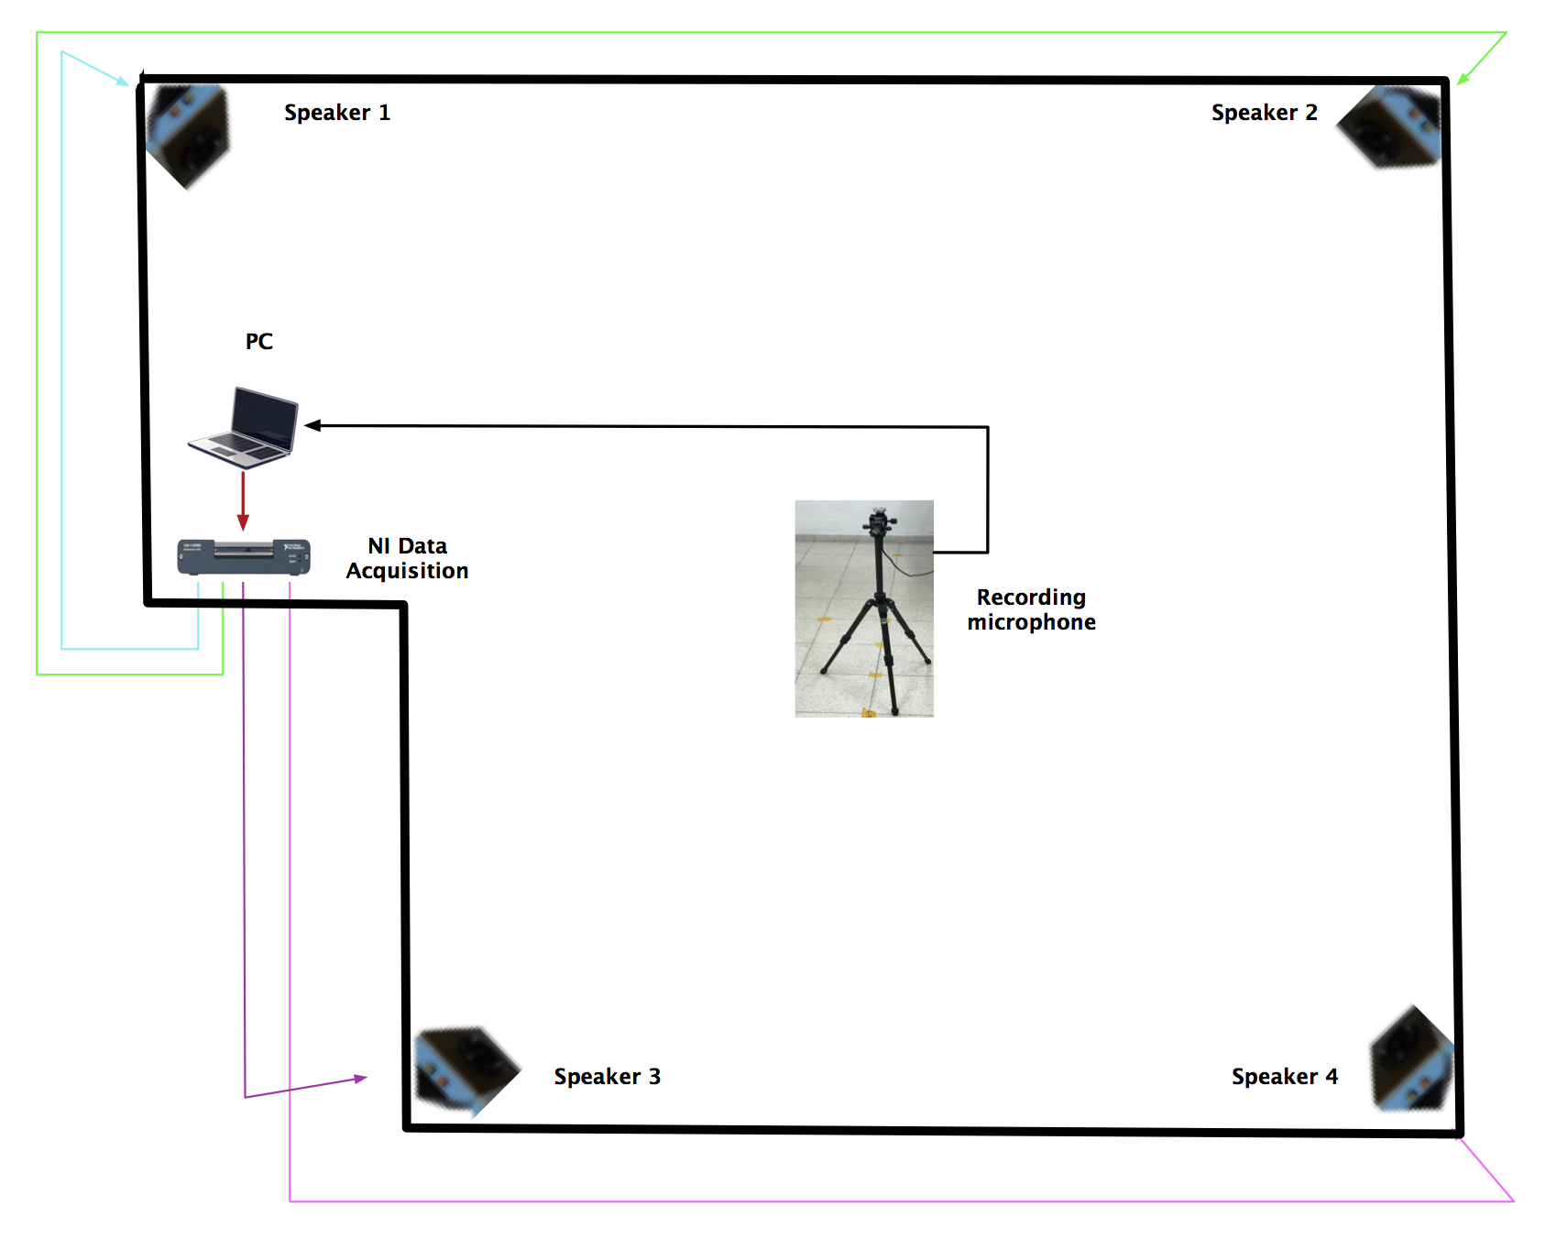
The Problem & setup Definitions
Setup scheme:
Notes:
Example objectives
At the end of this lesson, you will be able to:
Save files to the team Web server.
Move files to different locations on the team Web server.
Share files on the team Web server.

Slide 6
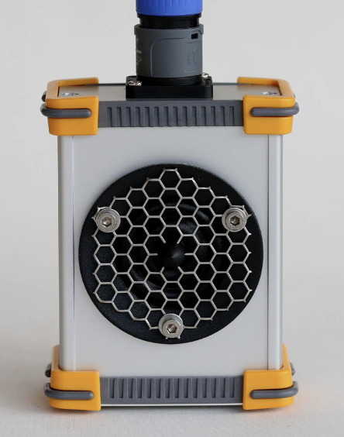
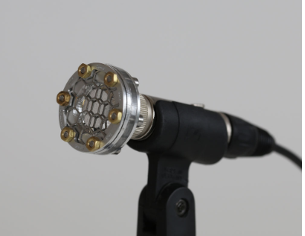
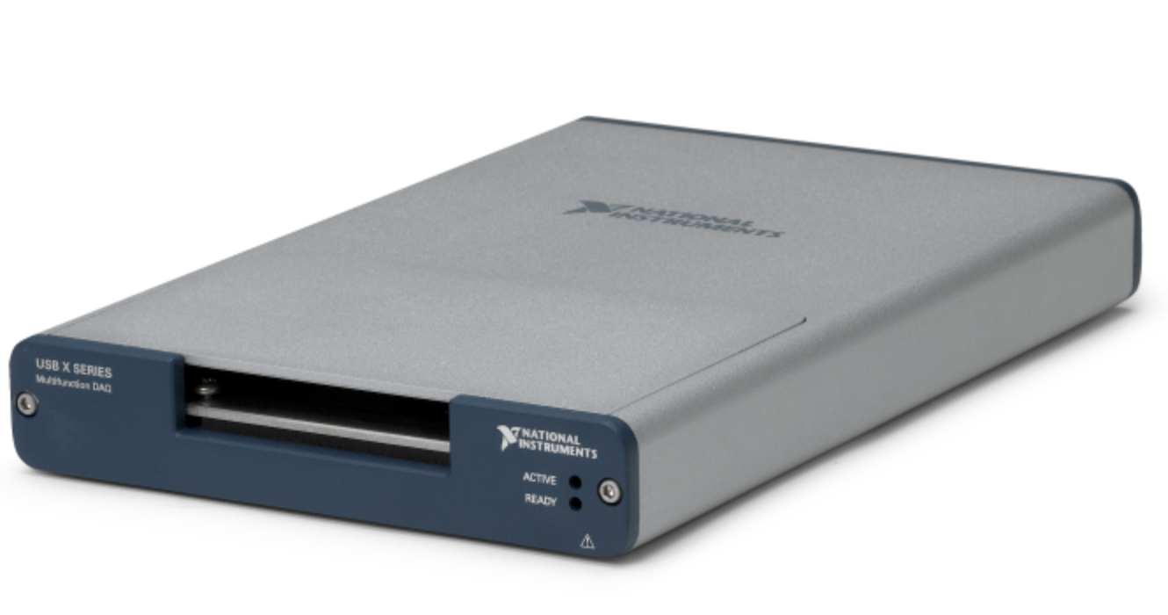
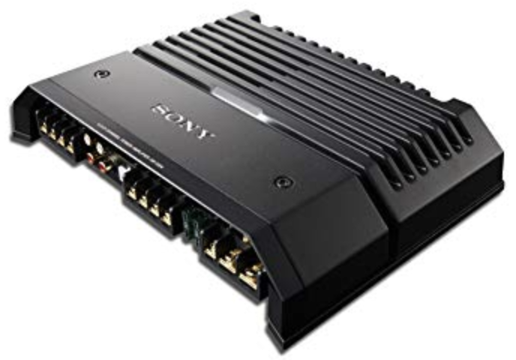
The Problem & setup Definitions
Hardware we use in the setup:
Ultrasonic Dynamic Speaker Vifa of Avisoft
UltraSoundGate CM16/CMPA model microphone of Avisoft
NI 6343 X Series Data Acquisition
Sony Vehicle Amplifier
Notes:
Example objectives
At the end of this lesson, you will be able to:
Save files to the team Web server.
Move files to different locations on the team Web server.
Share files on the team Web server.

Slide 7
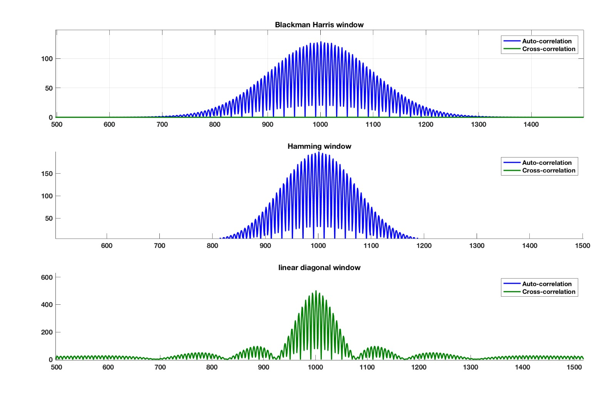
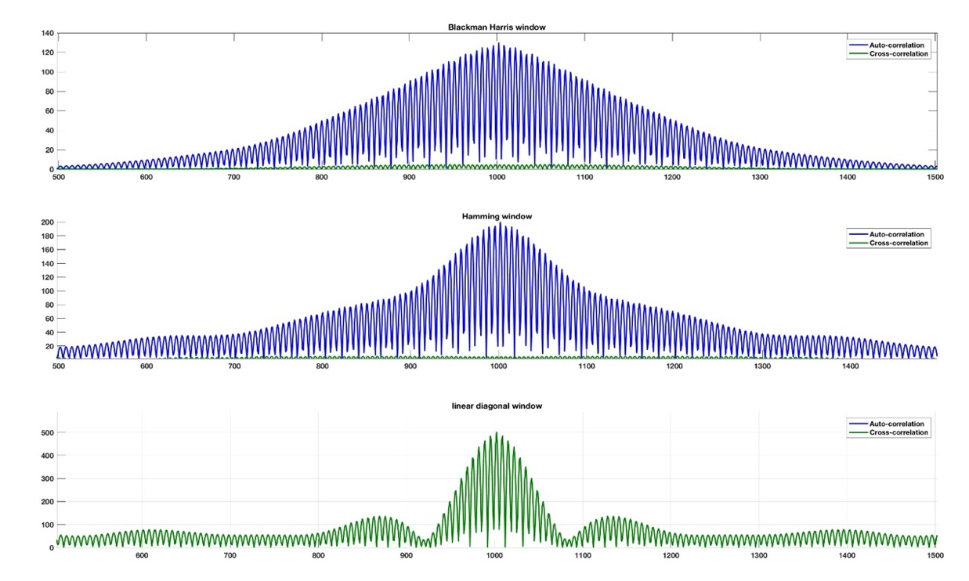
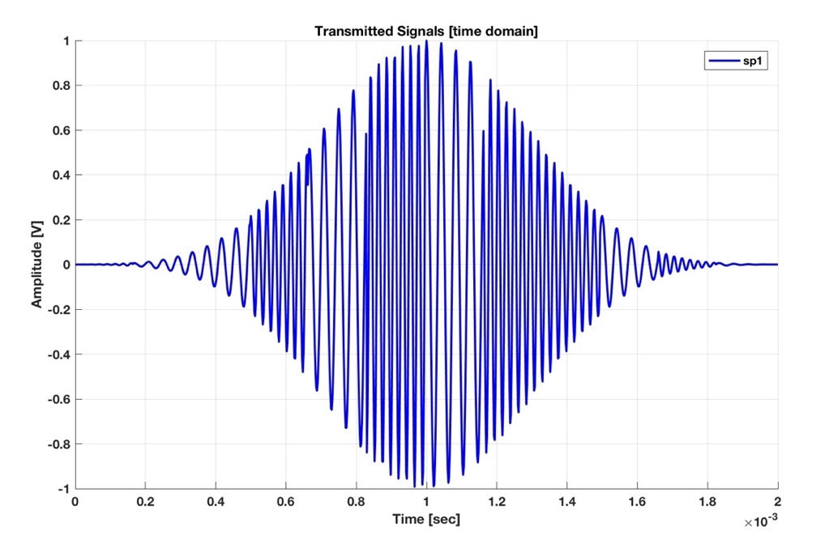
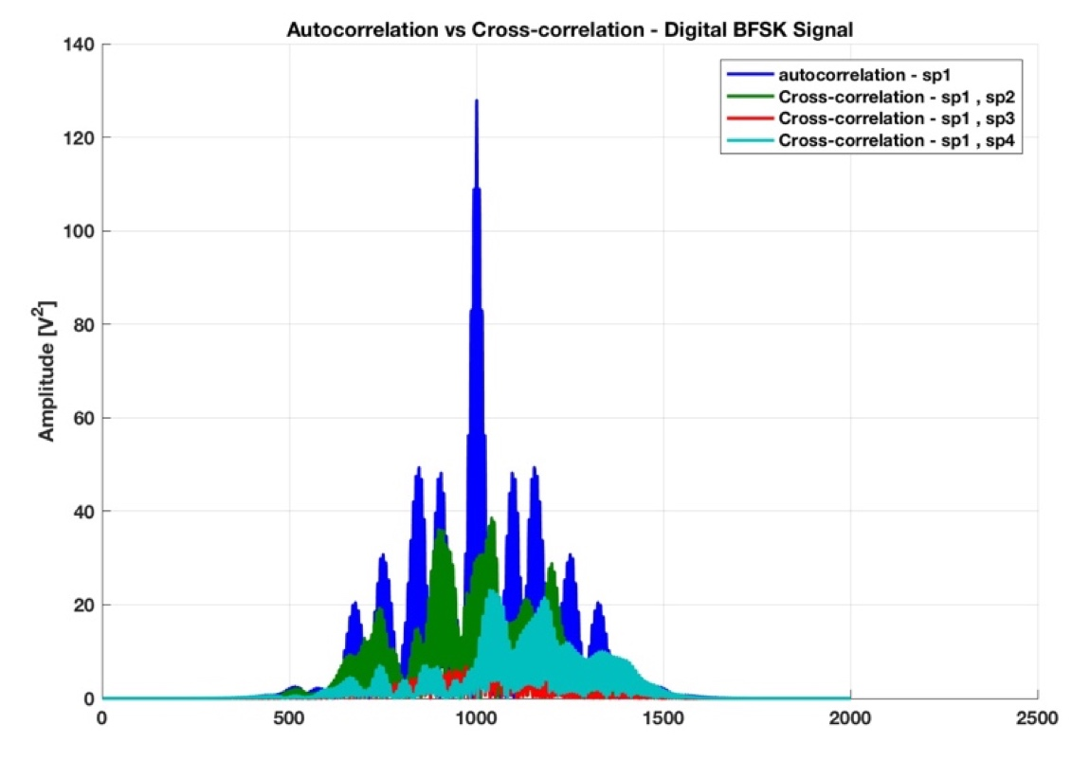
Suggested Algorithms
Choosing the transmitted signal
Comparison between 3 signals types:
Up/down chirp
Radar chirp (up and down)
BFSK random bit sequence
Amplitude
Amplitude

Slide 8
Suggested Algorithms
Choosing the transmitted signal
We decided to work with upsweep chirp with Blackman Harris envelop:
Hamming window generates a “click” noise while being transmitted which affected the received signal by the microphone.
Linear-Diagonal window, although the maximum peak is much higher compared to the other windows, we noticed that the autocorrelation is equal to the cross-correlation between two different speaker’s signals.
Blackman-Harris window has an almost zero cross correlation, and a good autocorrelation.
Upchirp and downchirp gave the same results.
The up-down chirp yielded a much thicker lobe, which means a less distinguishable maximum peak.
The digital signal shows good theoretical performance and we test it too.

Slide 9
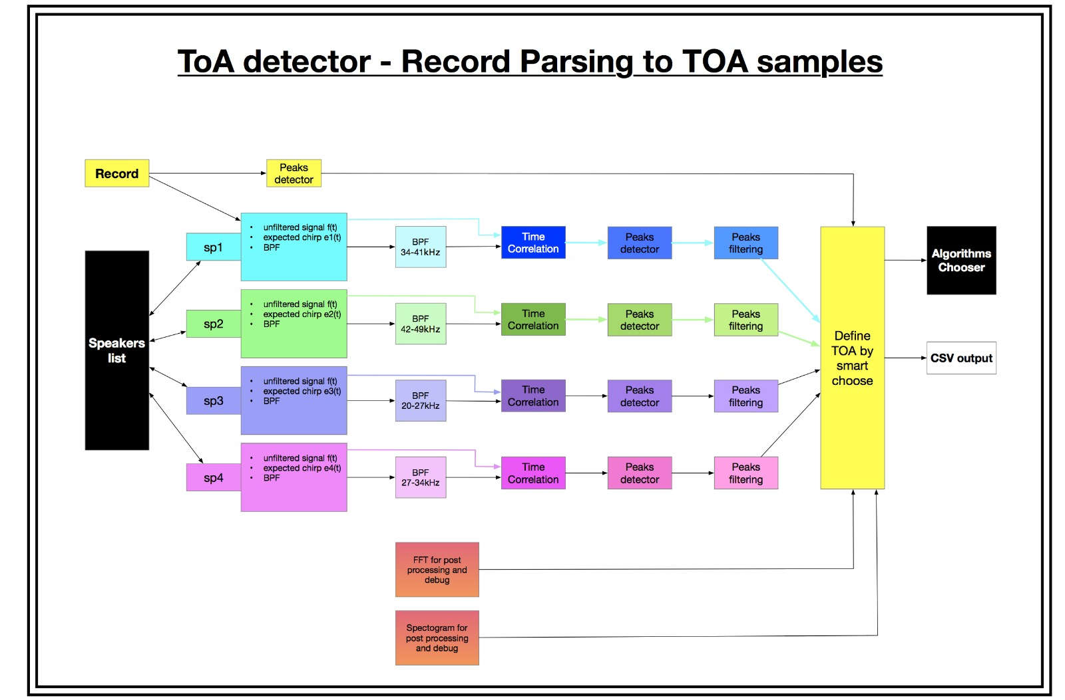
Suggested Algorithms
Time of Arrival Detector
Filtering the record signal for each speaker BW
Cross correlation with expected signal.
Find main peaks in order to define timestamp.
Fine tuning and determine the first significant peak.
Filtering outliers results with Gaussian model based on TDOA samples.

Slide 10
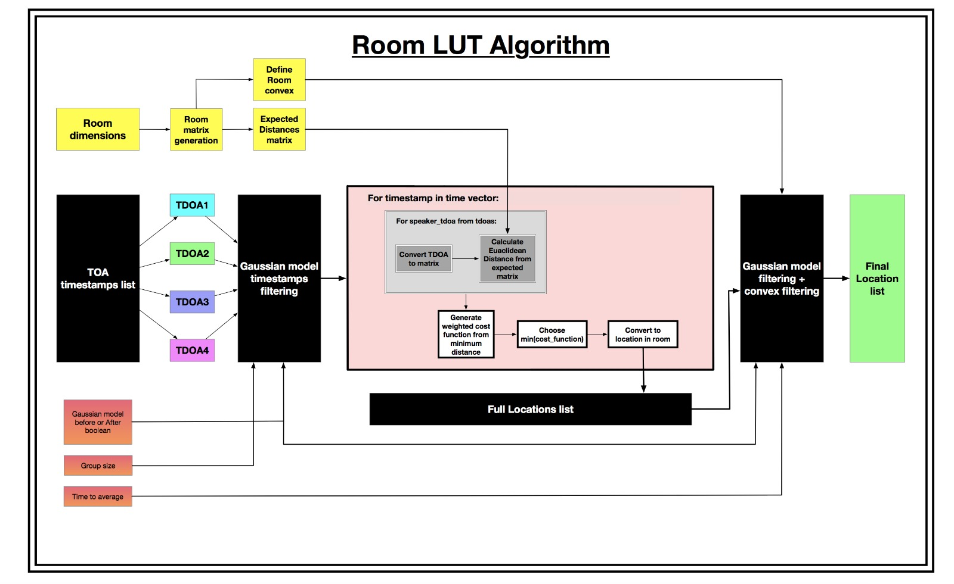
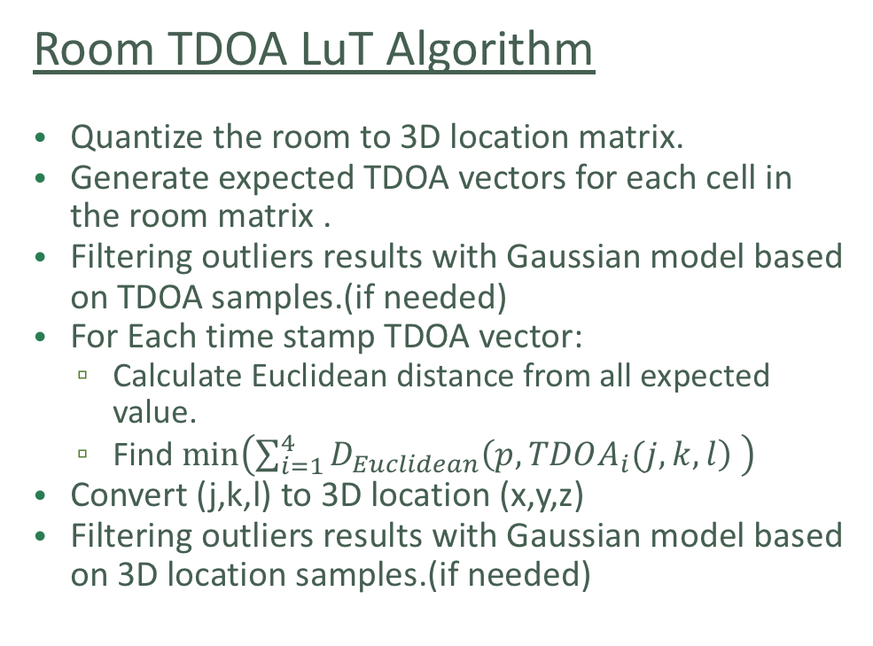
Suggested Algorithms
Room TDOA LuT Algorithm
Quantize the room to 3D location matrix.
Generate expected TDOA vectors for each cell in the room matrix .
Filtering outliers results with Gaussian model based on TDOA samples.(if needed)
For Each time stamp TDOA vector:
Calculate Euclidean distance from all expected value.
Find $\min\left(\sum_{i=1}^{4}{D_{Euclidean}\left(p,TDOA_{i}(j,k,l\right) }\right)$
Convert (j,k,l) to 3D location (x,y,z)
Filtering outliers results with Gaussian model based on 3D location samples.(if needed)

Slide 11
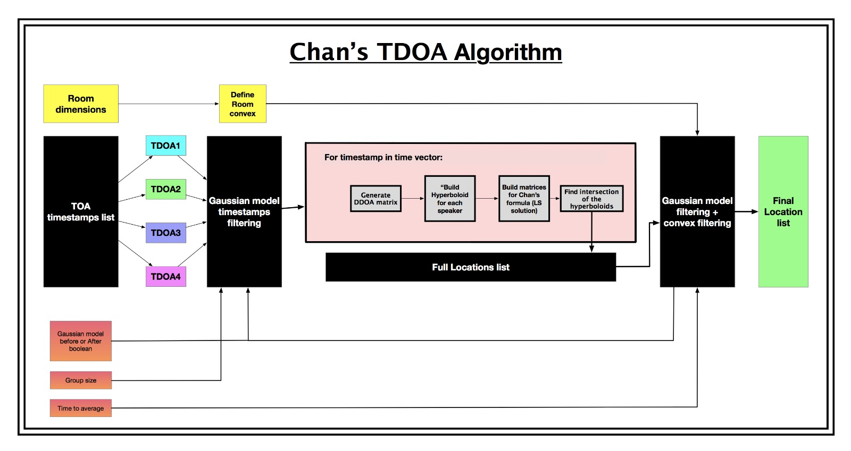
Suggested Algorithms
Chan’s TDOA Algorithm
Define room convex.
For Each time stamp TDOA vector:
Generate DDOA matrix
For each speaker Build hyperboloid of all optional locations of the microphone relative to this speaker.
Find intersection of the hyperboloids by solving linear equations system.
Define the middle of the intersection volume as the location.
Filtering outliers results with Gaussian model based on 3D location samples.(if needed)

Slide 12
Difficulties
Define the locations of the speakers to avoid bad ambiguity function values.
Define the global way to choose the ToA.
Avoid from Chan’s algorithm divergence.
Errors in Z axis.
Immunity to interferers.
Voice speed as function of temperature.
Humam errors.
Running time

Slide 13
Results
Test results comparison with Simulation
Algorithm |  | Average Error [m]
LuT | 2D (3D with constant Z) | 0.048
 | 3D | 0.375
 | 2D (without constant Z) | 0.1
 | simulation | 2.45E-09
Chan | 2D (3D with constant Z) | 1.2
 | 3D | 2.81
 | Simulation | 2.23E-05

Slide 14
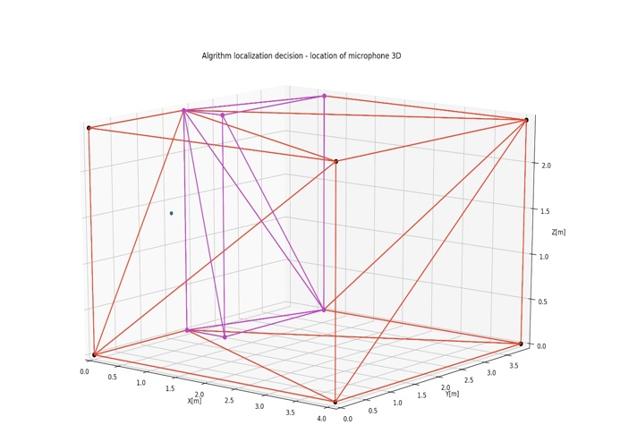
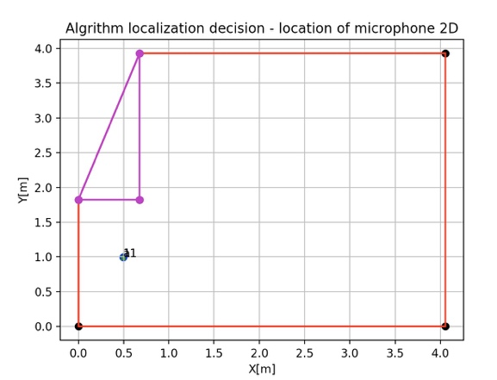
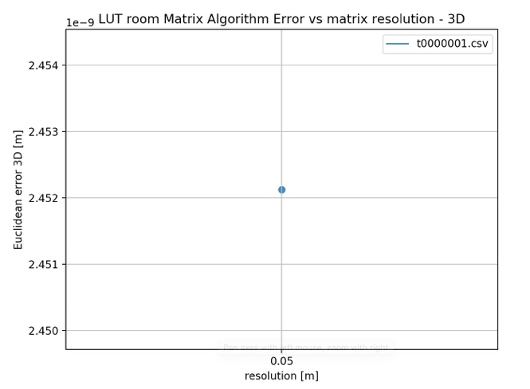
Results
Location of microphone in 3D
Location of microphone in 2D
Simulation results
LuT algorithm
LuT error vs matrix resolution

Slide 15
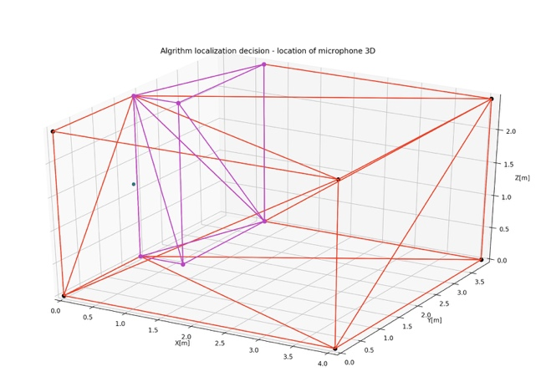
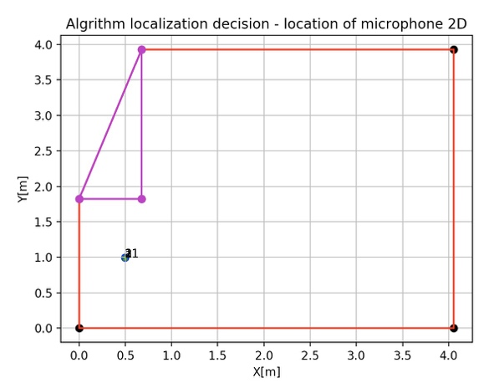
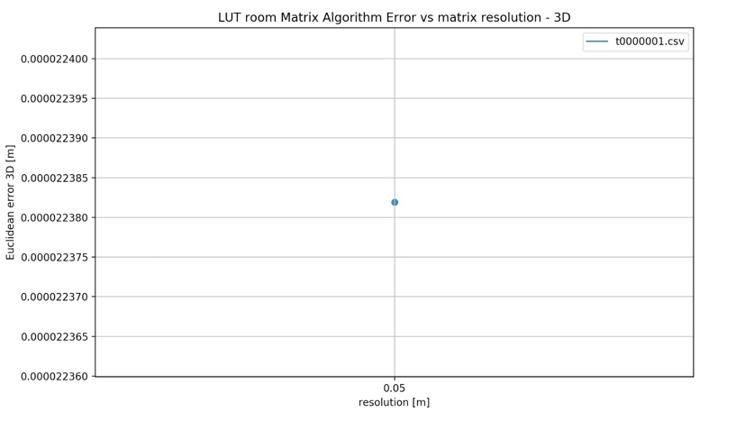
Results
Location of microphone in 3D
Location of microphone in 2D
Simulation results
Chan’s TDOA algorithm
Chan’s algorithm error vs matrix resolution
Simulation results comparison
Algorithm | Error
LuT | 2.45E-09
Chan | 2.24E-05

Slide 16
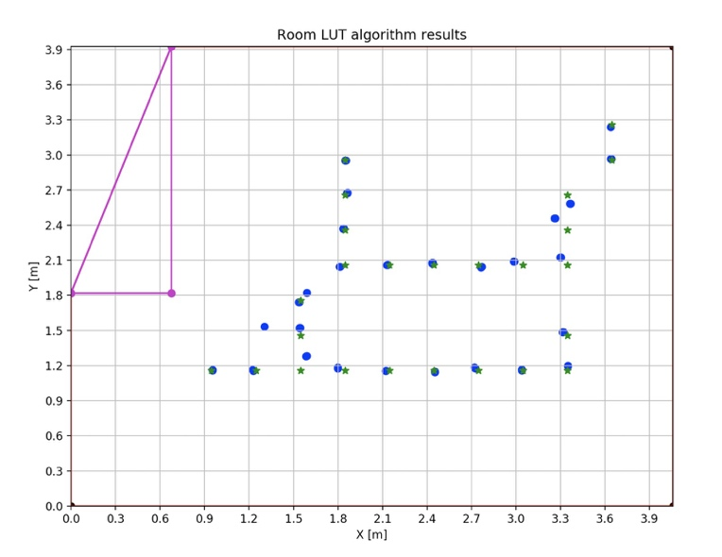
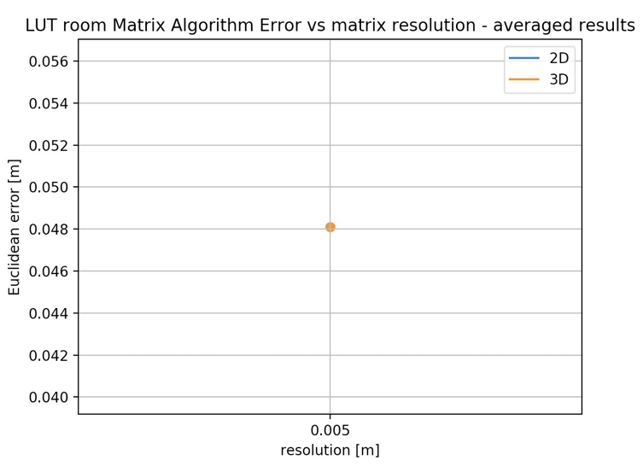
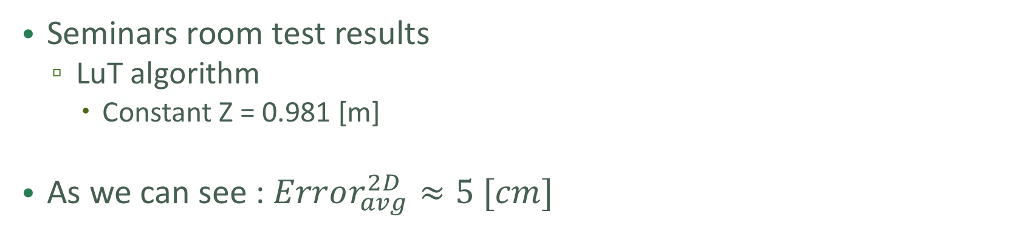
Results
Seminars room test results
LuT algorithm
Constant Z = 0.981 [m]
As we can see : $Error_{avg}^{2D}≈5 [cm]$

Slide 17
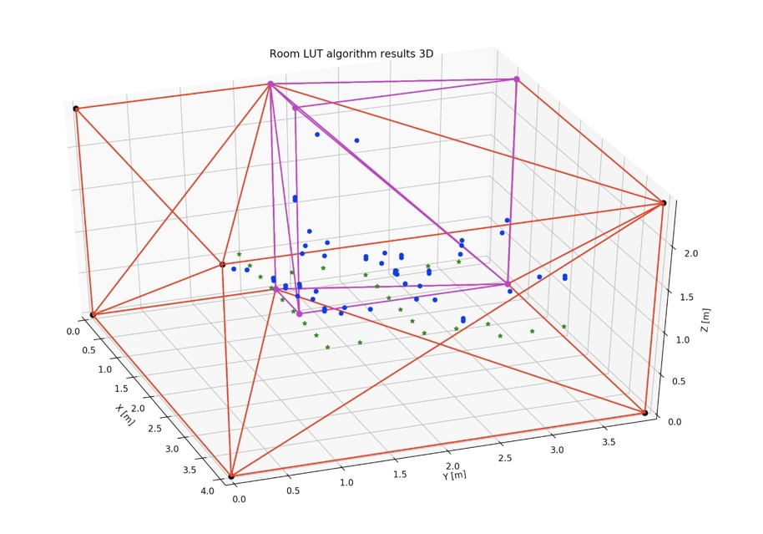
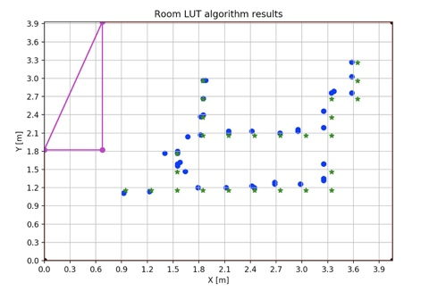
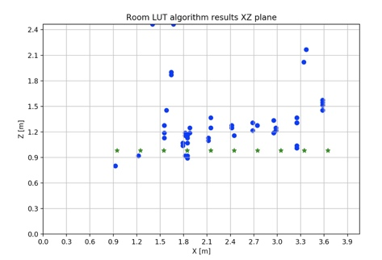
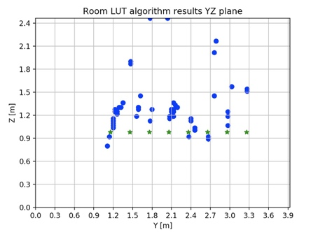
Results
Seminars room test results
LuT algorithm
No constant Z (3D)

Slide 18
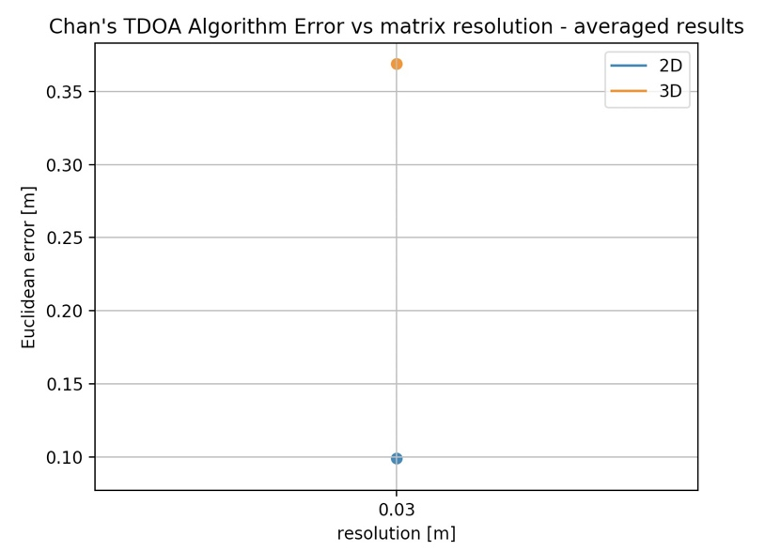
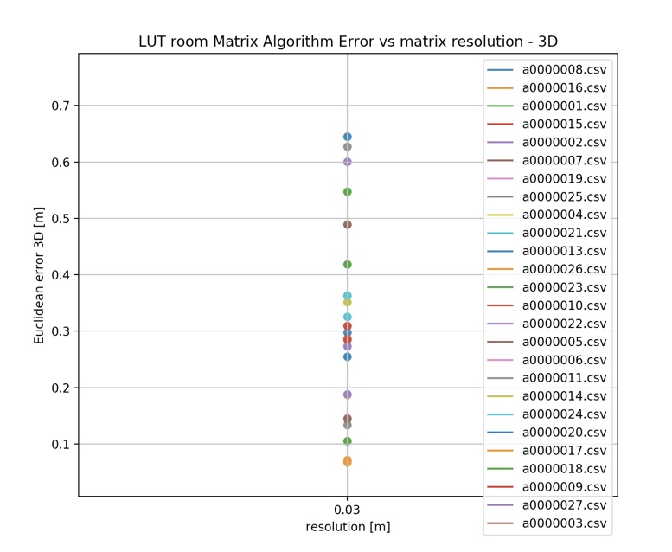
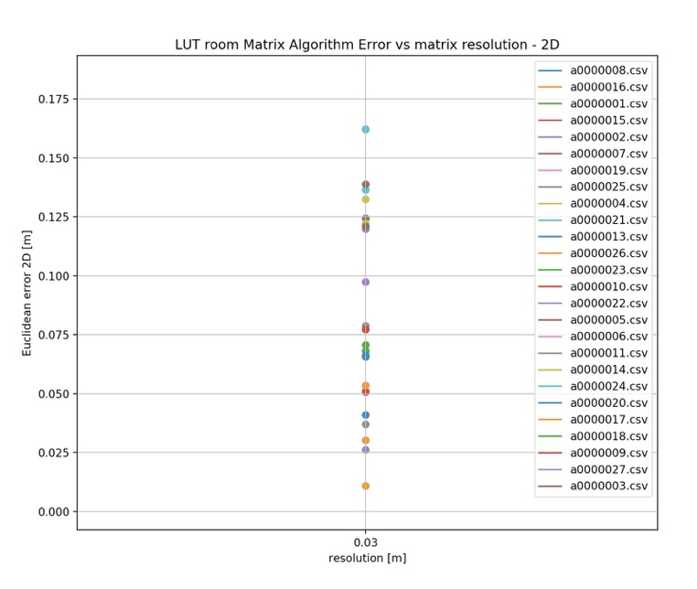
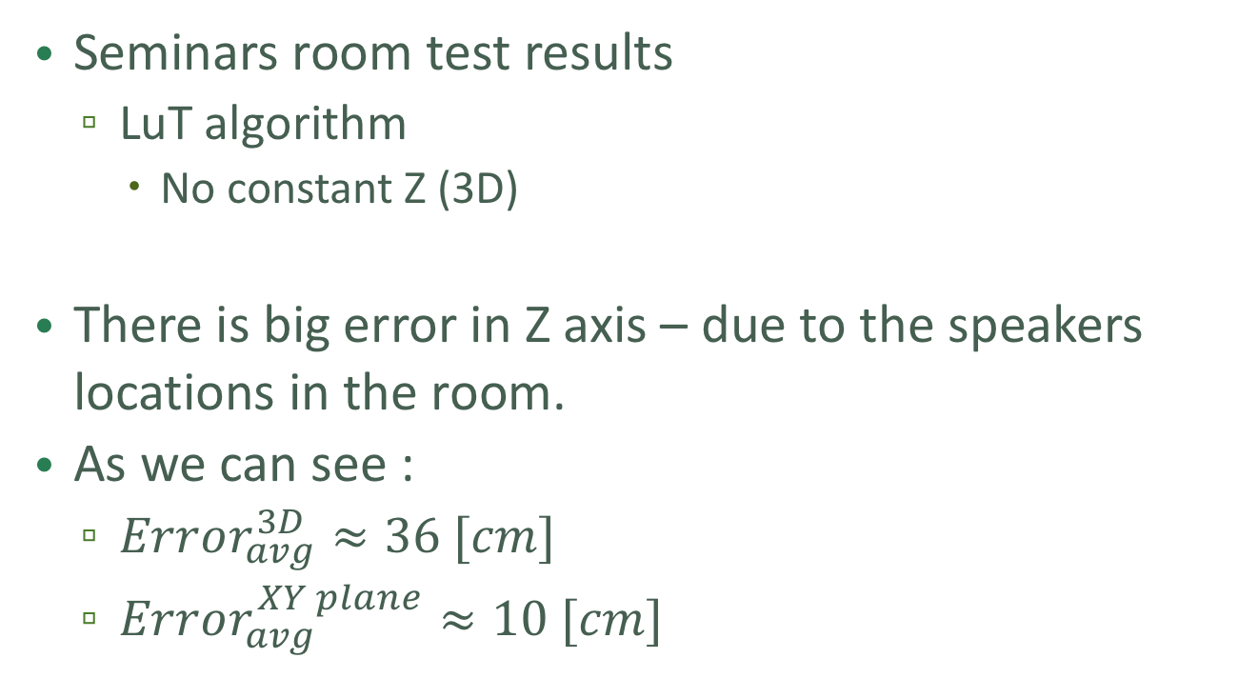
Results
Seminars room test results
LuT algorithm
No constant Z (3D)
There is big error in Z axis – due to the speakers locations in the room.
As we can see :
$Error_{avg}^{3D}≈36 [cm]$
$Error_{avg}^{XY plane}≈10 [cm]$

Slide 19
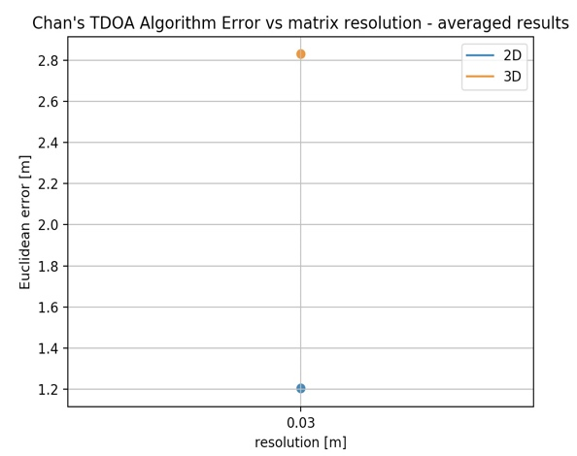
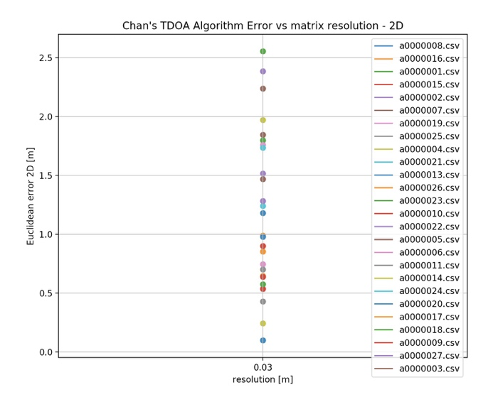
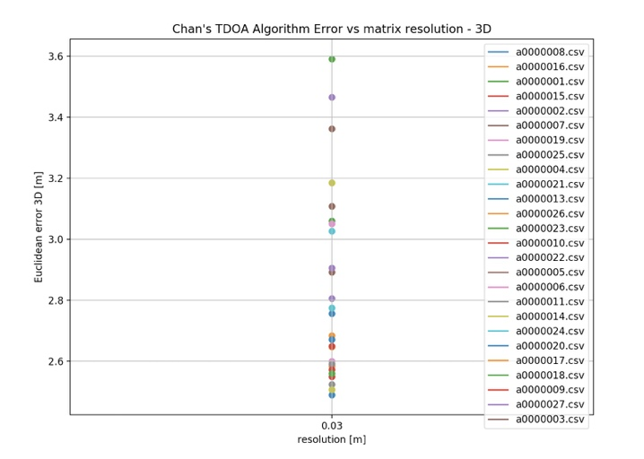
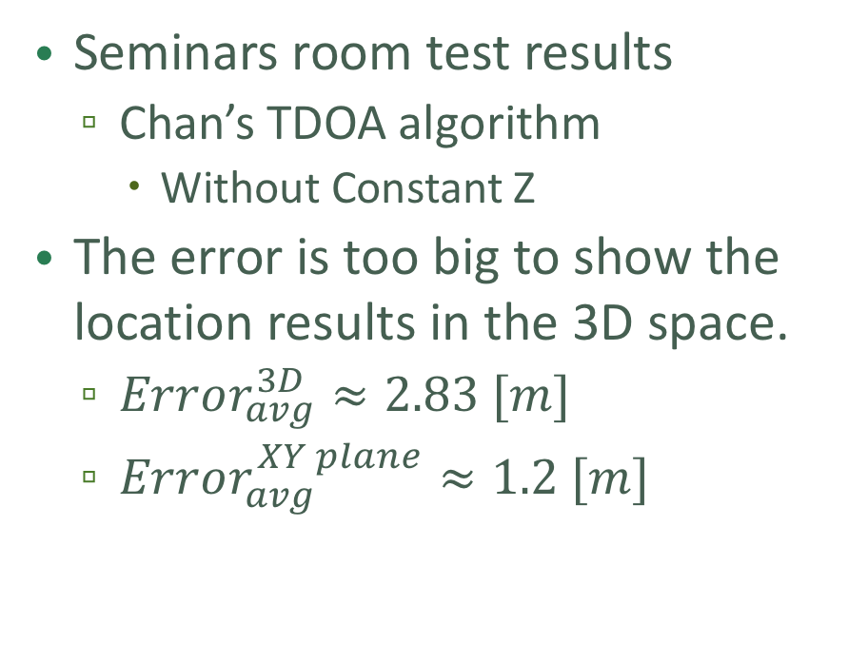
Results
Seminars room test results
Chan’s TDOA algorithm
Without Constant Z
The error is too big to show the location results in the 3D space.
$Error_{avg}^{3D}≈2.83 [m]$
$Error_{avg}^{XY plane}≈1.2 [m]$

Slide 20
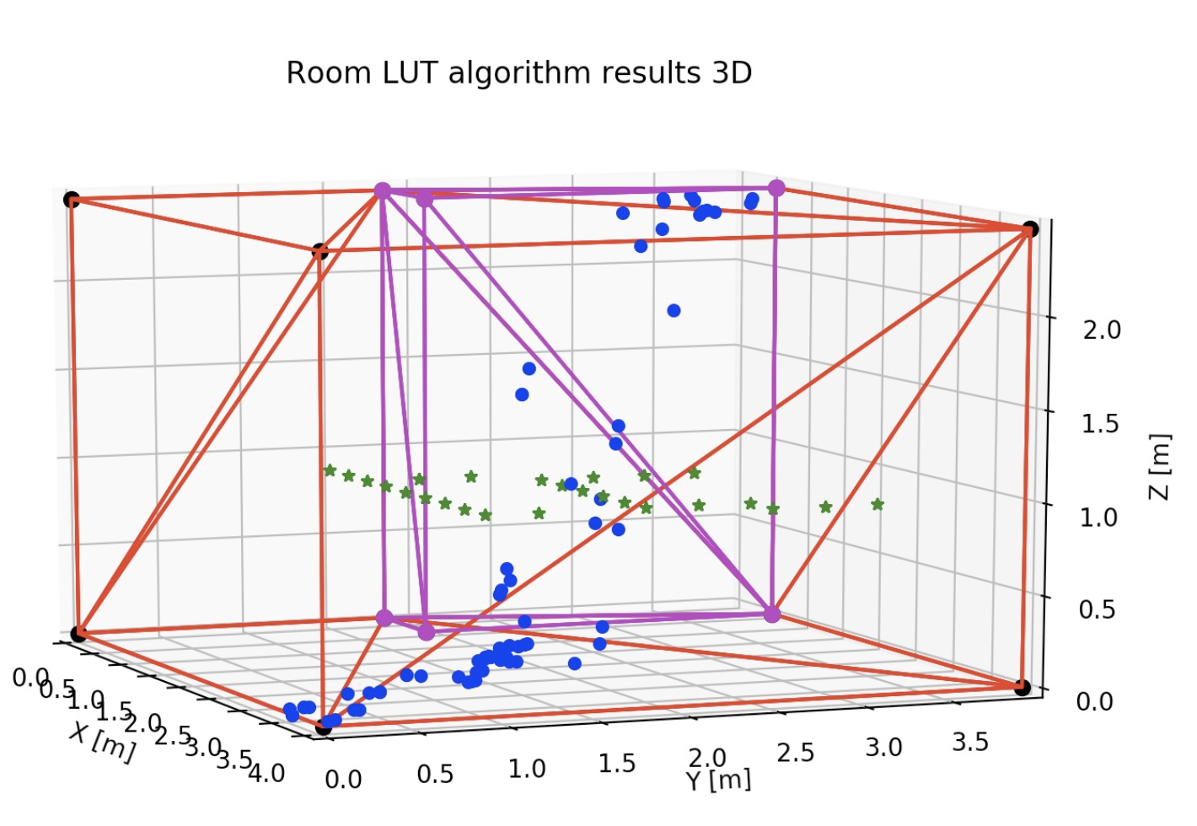
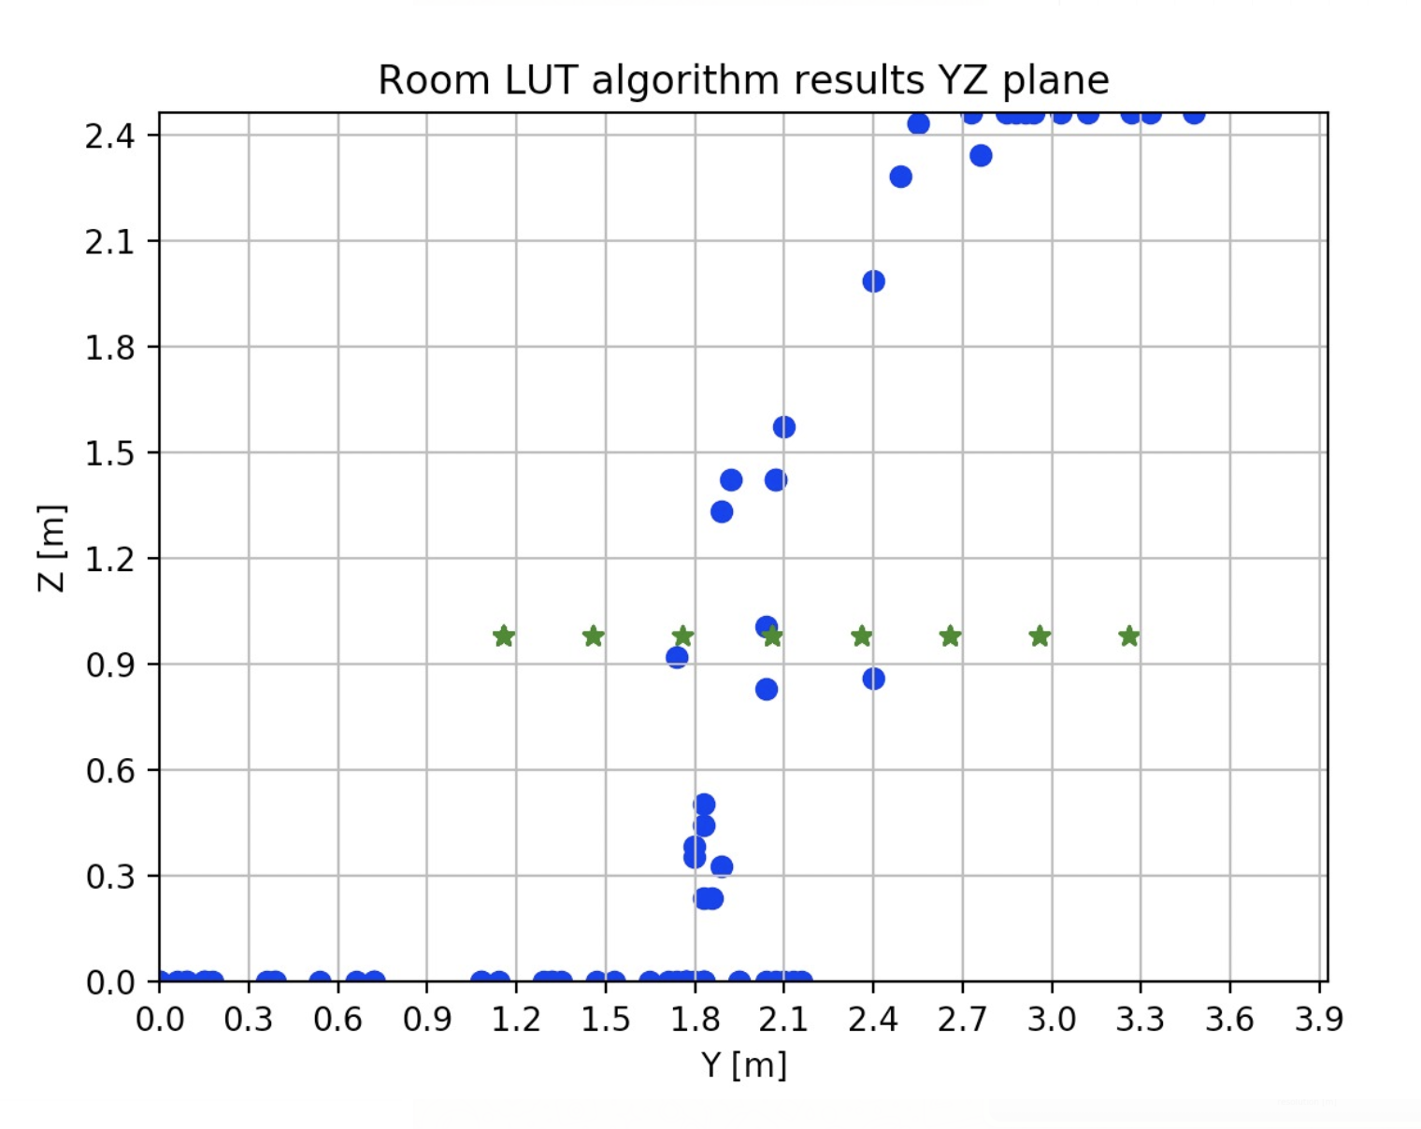
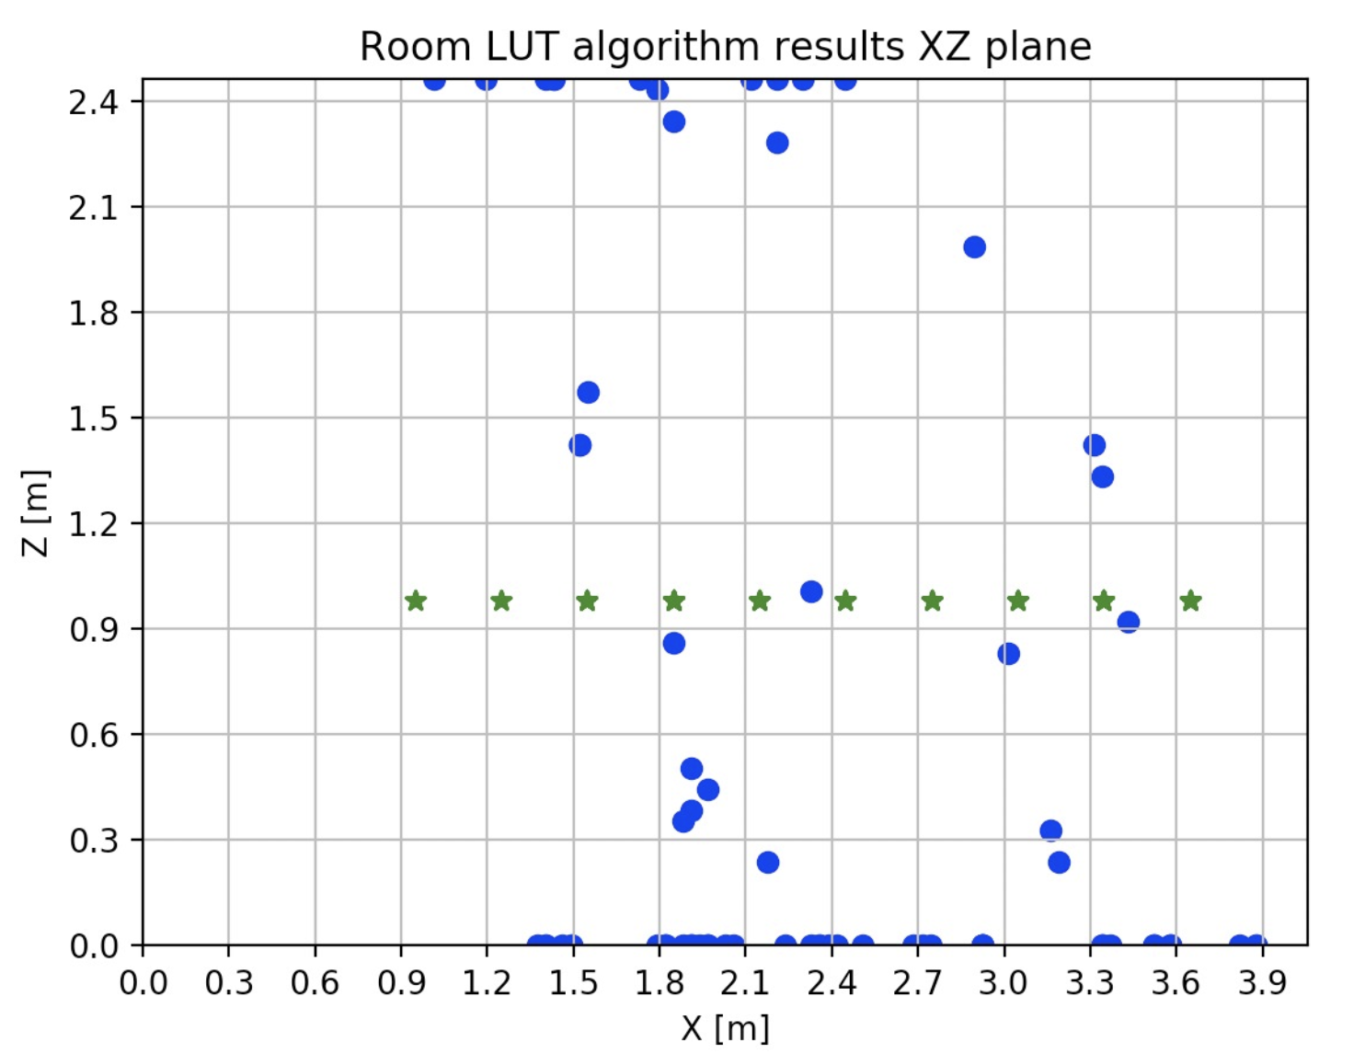
Results – Digital signal
Seminars room test results
LuT algorithm
No constant Z (3D)

Slide 21
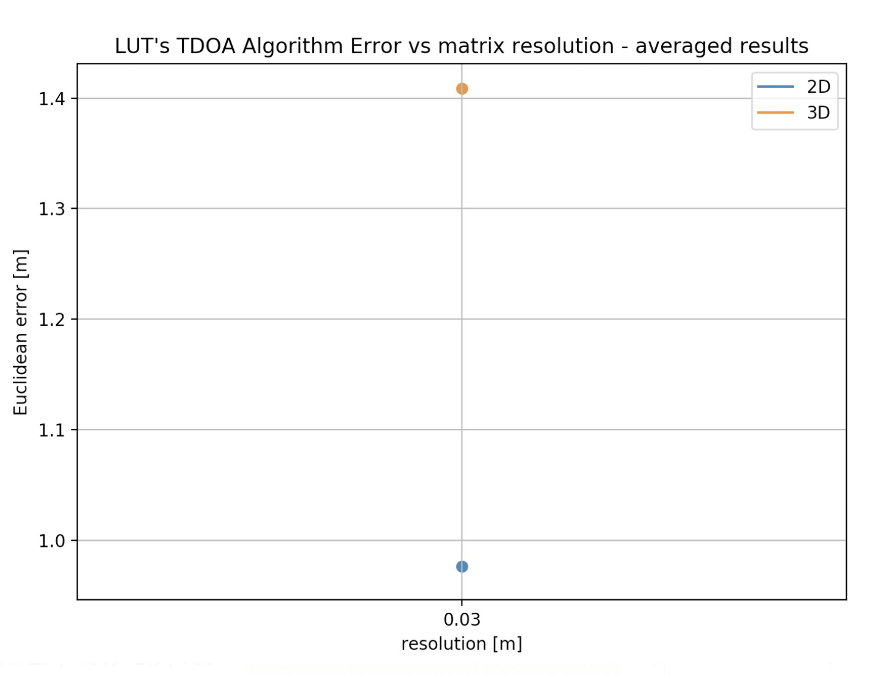
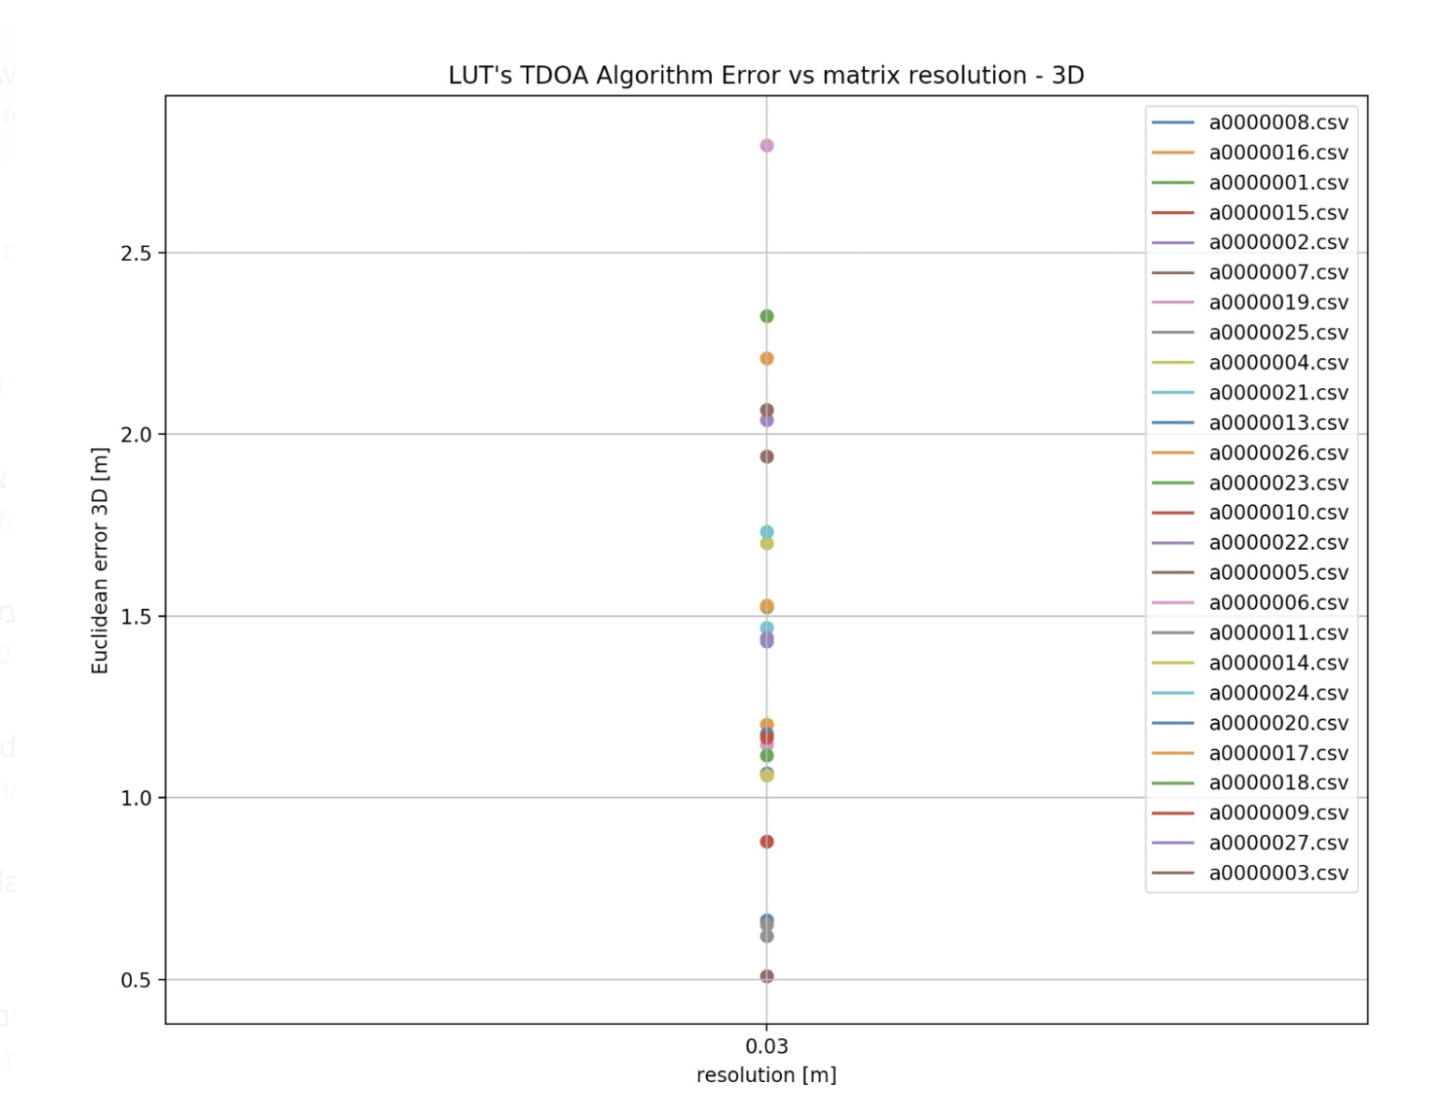
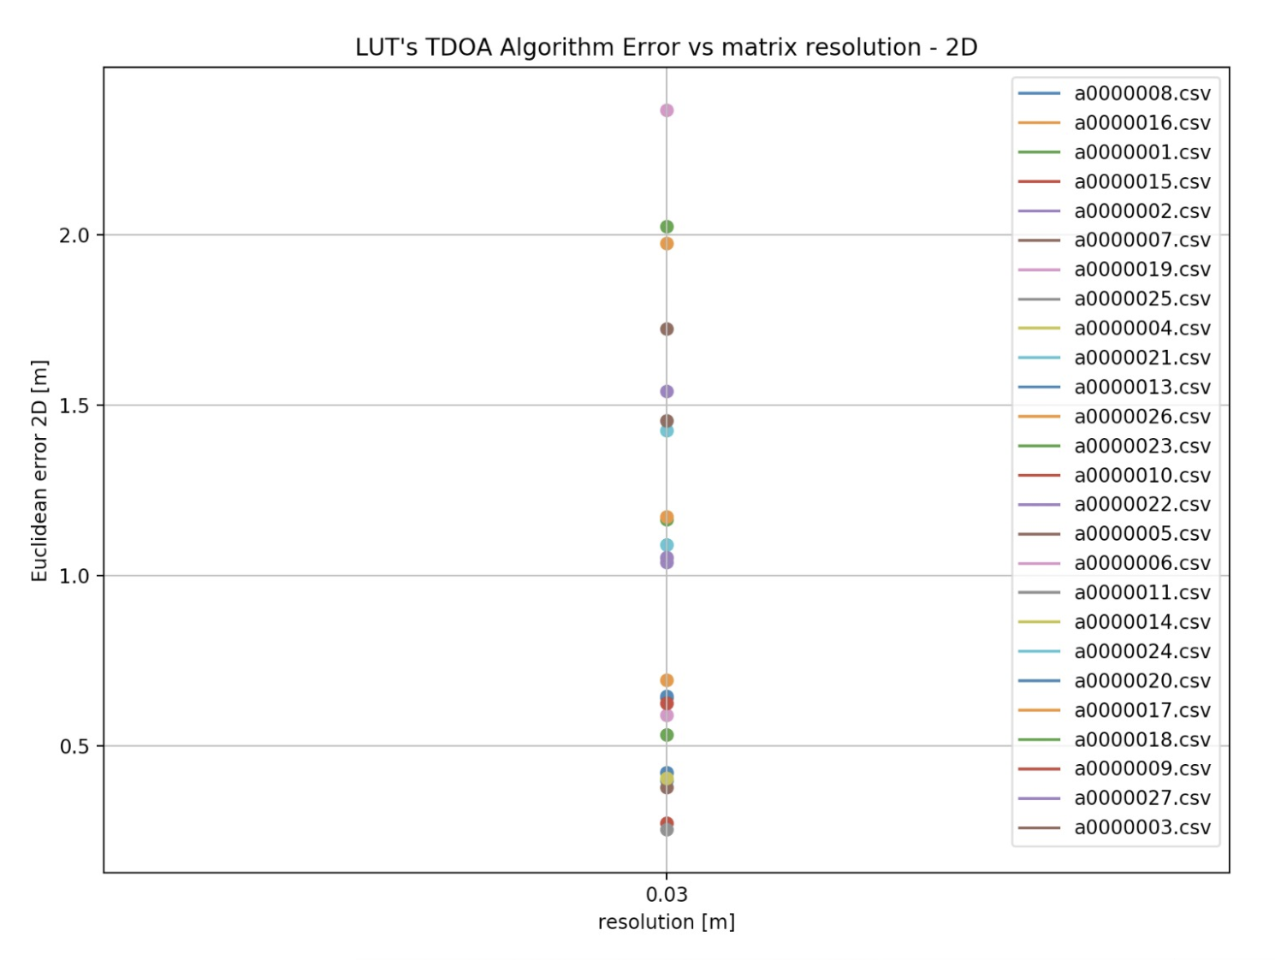
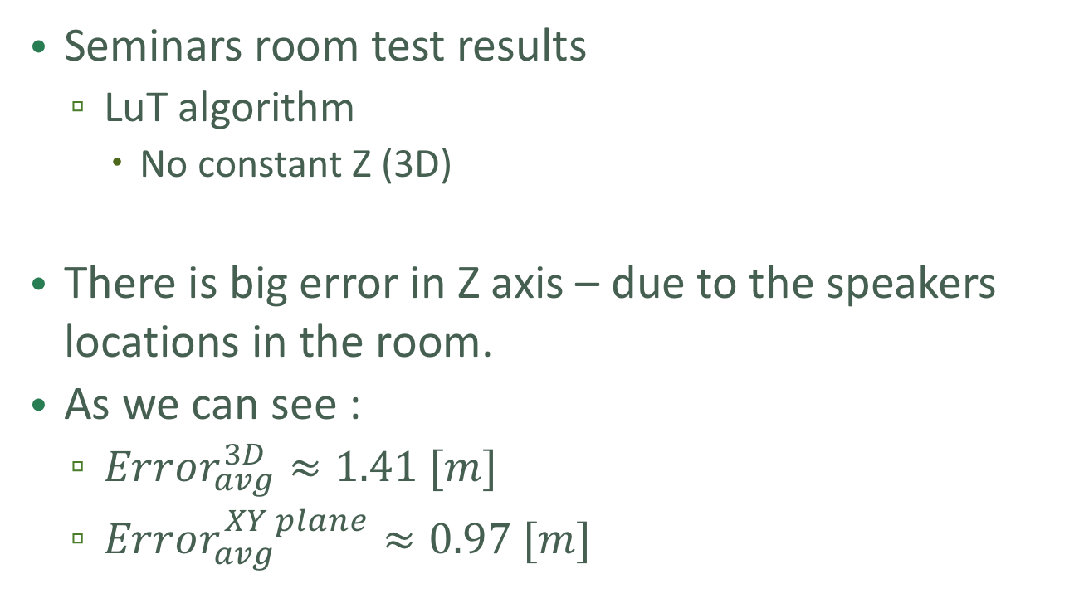
Results – Digital signal
Seminars room test results
LuT algorithm
No constant Z (3D)
There is big error in Z axis – due to the speakers locations in the room.
As we can see :
$Error_{avg}^{3D}≈1.41 [m]$
$Error_{avg}^{XY plane}≈0.97 [m]$

Slide 22
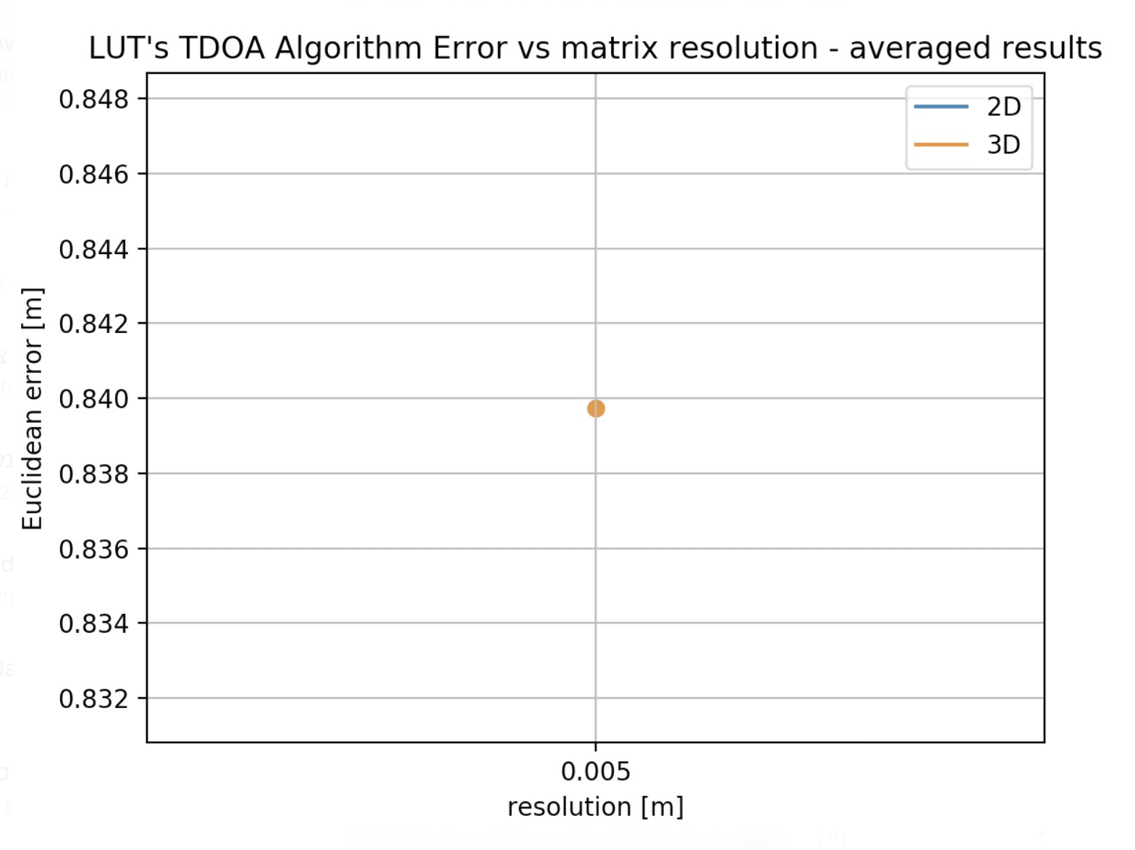
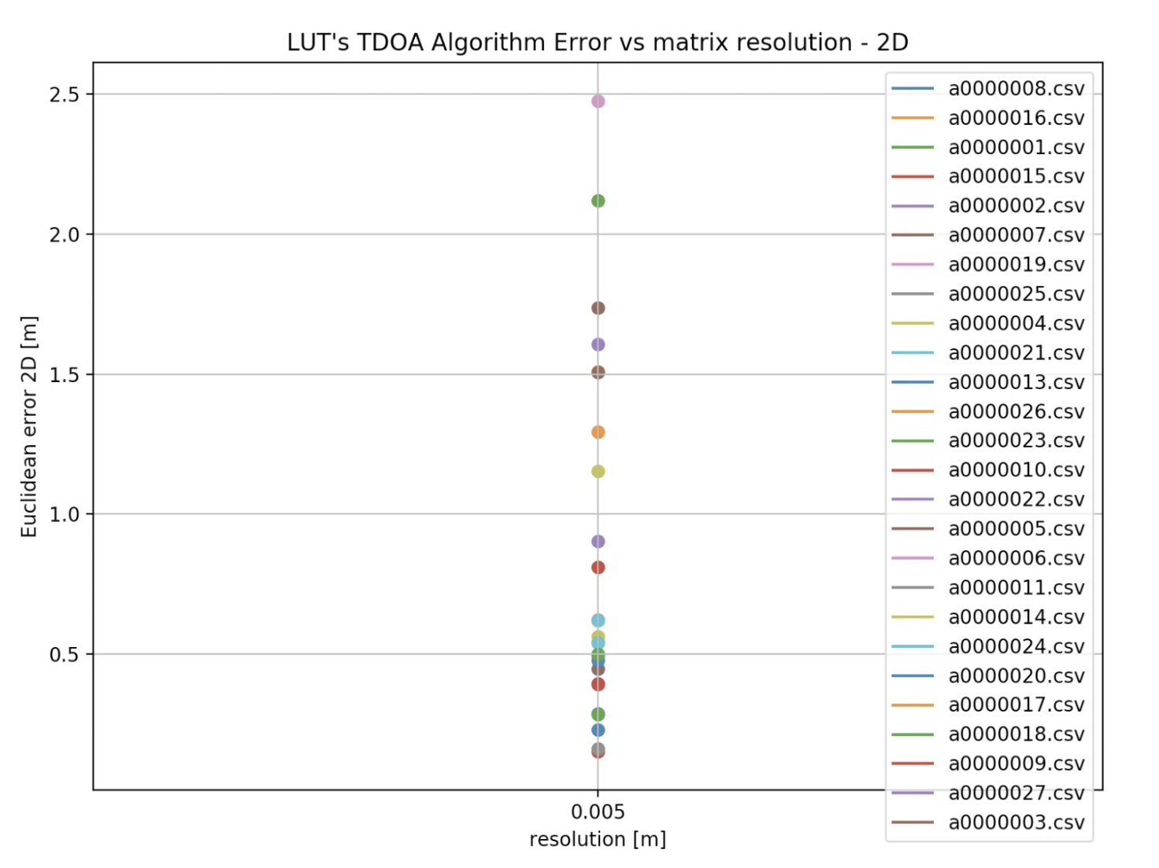
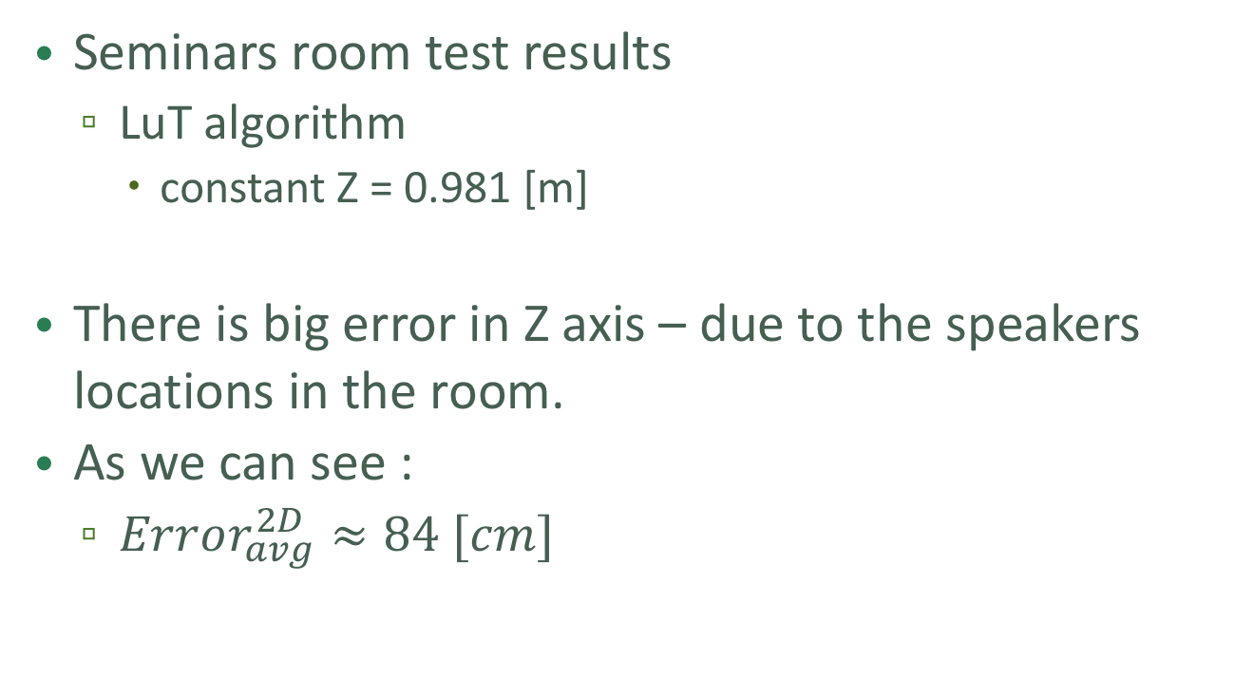
Results – Digital signal
Seminars room test results
LuT algorithm
constant Z = 0.981 [m]
There is big error in Z axis – due to the speakers locations in the room.
As we can see :
$Error_{avg}^{2D}≈84 [cm]$

Slide 23
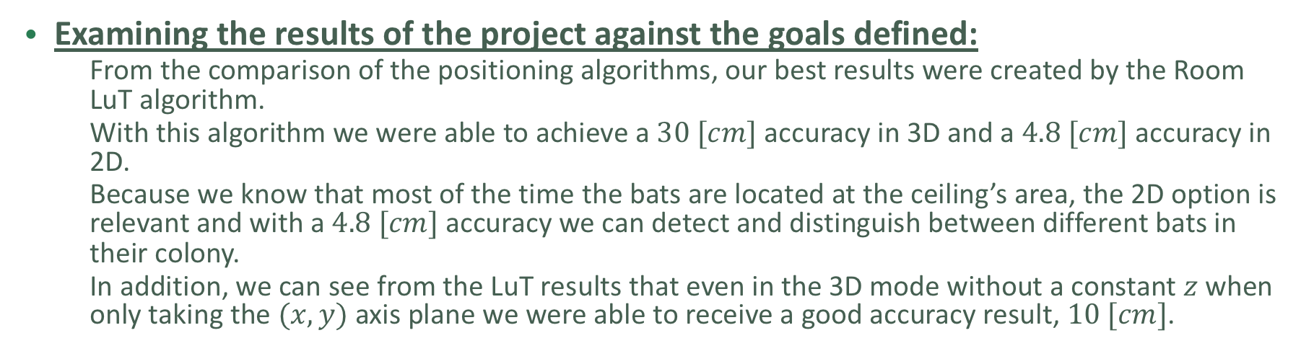
Conclusions
Examining the results of the project against the goals defined:
From the comparison of the positioning algorithms, our best results were created by the Room LuT algorithm.
With this algorithm we were able to achieve a $30 [cm]$ accuracy in 3D and a $4.8 [cm]$ accuracy in 2D.
Because we know that most of the time the bats are located at the ceiling’s area, the 2D option is relevant and with a $4.8 [cm]$ accuracy we can detect and distinguish between different bats in their colony.
In addition, we can see from the LuT results that even in the 3D mode without a constant $z$ when only taking the $(x,y)$ axis plane we were able to receive a good accuracy result, $10 [cm]$.

Slide 24
Conclusions
Options for future work (development / research)
It is needed to further research Chan’s algorithm in order to avoid as much as possible any divergence and interferences. In addition, continuing looking into ways to improve Chan’s algorithm or find an alternative algorithm.
Another aspect for future research is the influence the Z axis has on the result’s accuracy.
Further investigate different signals and envelops to transmit in order to increase accuracy.
Continue to develop and improve the digital signal to be usable for future work.
Improving the running time of the code, to be able to implement our project in a real-time system.
Create an easy user interface so the code will be accessible to any person that wishes to work with our system.

